Slide 1



AI AUTHENTICITY CHECKER
SPOT

Slide 2



ABOUT US
Product Overview:
AI Authenticity Checker is an innovative application designed to verify the authenticity of videos, audio clips, and images. It utilizes advanced artificial intelligence algorithms to distinguish between genuine and AI-generated content. This application aims to combat the rise of deepfakes and enhance the credibility of visual and auditory media.
Target Audience:
1. Celebrities: Protect the reputation and credibility of public figures by ensuring that the media associated with them is genuine.
2. Small Time Influencers: Safeguard influencers from malicious content that can harm their online presence and trustworthiness.
3. General Audience: Empower the everyday internet user to discern between real and manipulated media, promoting a safer online environment.
4. Journalistic Publications (May include celebrity gossip websites) as well to verify their sources

Slide 3
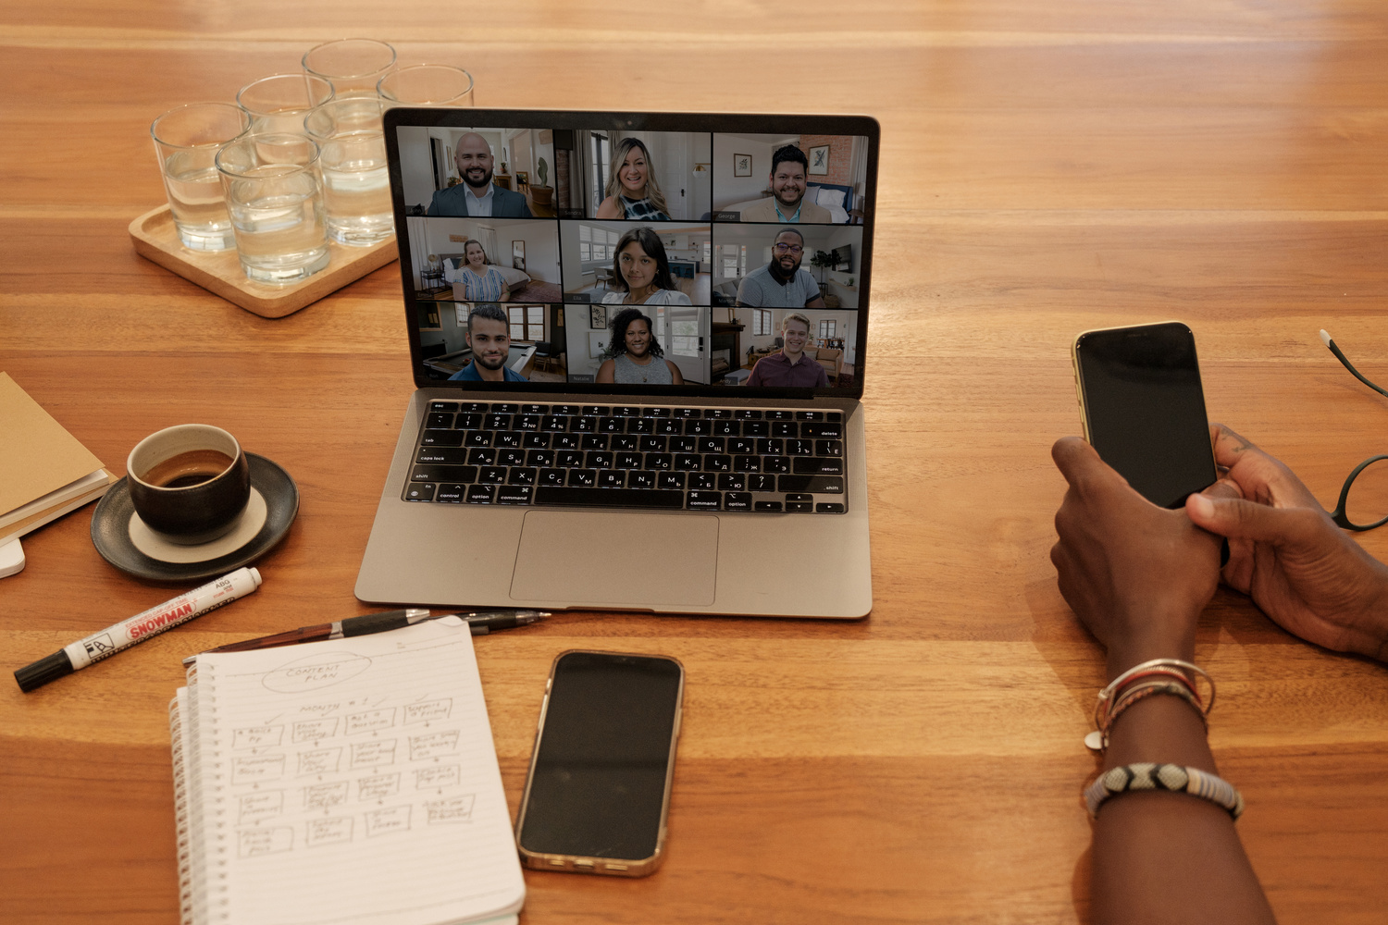

Vision
Empowering a world where trust in digital media prevails, our AI Authenticity Checker envisions becoming the foremost guardian against misinformation, deepfakes, and manipulated content, ensuring the authenticity of visual and auditory media across diverse online platforms.
Mission
Our mission is to pioneer advanced artificial intelligence algorithms within the AI Authenticity Checker, setting new standards in the battle against deepfakes and deceptive edits. We are dedicated to enhancing the credibility of videos, audio clips, and images, thereby safeguarding the integrity of digital content and fostering a culture of trust and reliability in the digital age.

Slide 4
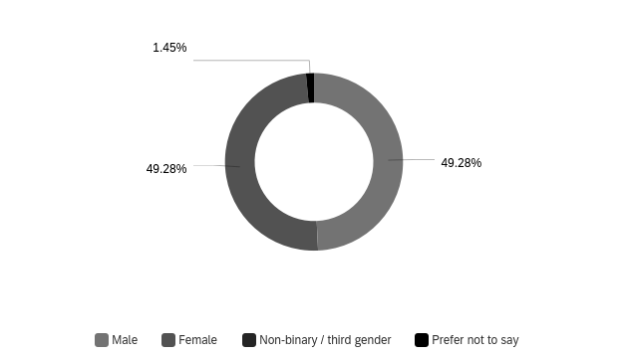
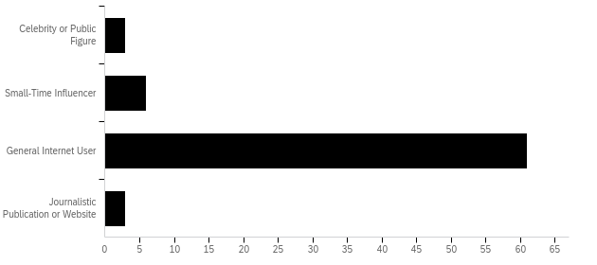
SURVEY REPORT
Our survey is dependent on the data collected from 70 individuals. The survey had many relevant questions regarding our Product B i.e. AI Authenticity Checker. Here are the survey results:
The gender distribution in our audience consisted of 51% female and 49% male.
The data reveals that the majority of users, around 83.56%, are general internet users, while 8.22% are small-time influencers. Celebrity or public figure and journalistic publication or website users each make up 4.11% of the data.

Slide 5
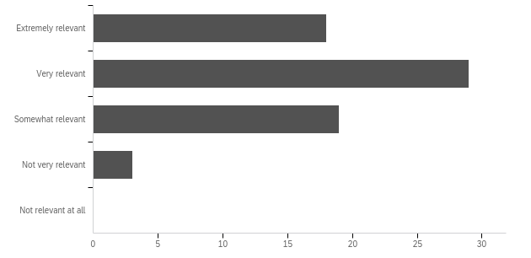
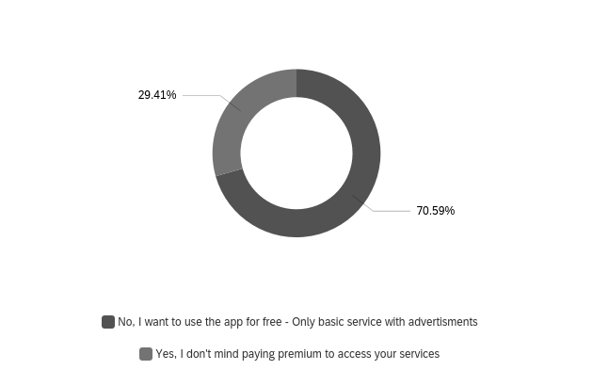
SURVEY REPORT
Based on the feedback received, an overwhelming 97% of respondents perceived this tool as highly relevant and invaluable for the general public's protection against identity theft. It stands out as a unique solution in the market, as there are currently no similar products available.
The data indicates that a significant majority, approximately 70.59%, prefer to use the app for free, even if it means experiencing basic services with advertisements. On the other hand, 29.41% of respondents are willing to pay for a premium version to access the app's services. This shows a clear divergence in user preferences regarding payment and ad-supported usage.

Slide 6

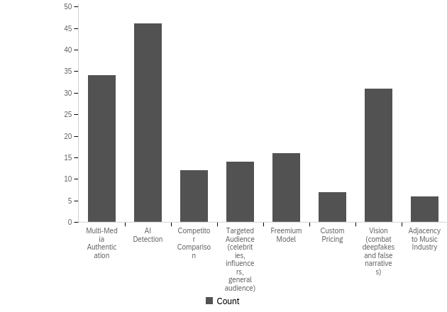
The data presents various approaches or features within a context that seems to relate to a digital platform, potentially focusing on multimedia content. Among these, "AI Detection" is the most favored option, with 27.71% of respondents showing preference. "Multi-Media Authentication" and "Vision" to combat deepfakes and false narratives also have notable support at 20.48% and 18.67%, respectively. Other elements like "Targeted Audience," "Freemium Model," and "Custom Pricing" have moderate levels of interest, while "Adjacency to the Music Industry" is the least preferred option. The data suggests that AI-related features and content authentication are particularly significant for the respondents.
This advanced technology plays a pivotal role in determining the authenticity of videos, audios, and images, addressing the pressing issue of fake content that has become prevalent in the digital landscape. By doing so, it not only assists in protecting users from potential harm and deception but also contributes to fostering trust in what people encounter online. As a result, it substantially enhances the overall safety and security of the digital experience, ultimately benefiting the broader online community.

Slide 7





BUSINESS GOALS
Year - 1
Achieve 100,000 downloads within the first year after the public launch.
Attain a user satisfaction rate of 90% based on user feedback and reviews.
Year - 2
Establish partnerships with at least three educational institutions and two businesses for app integration and mutual promotion.
Release paid subscription
Attain user retention rate from 85 to 90%
Years - 3 to 4
Expand user base to 500,000 active users by the end of Year 4.
Secure partnerships with five international institutions, establishing the app's presence in at least three continents.
Achieve a 20% increase in monthly active users through referral programs and promotional campaigns.
Year-5
Expand services to include B2B solutions, targeting at least 20 businesses for partnerships and integration.
Achieve a 25% increase in revenue through premium subscription models and enterprise solutions.
Attain a user retention rate of 90% by providing personalized user experiences and proactive customer support.

Slide 8

RoadMap-Pre-Launch
2024
Q1
2024
Q2
2024
Q3
2024
Q4
2025
Q1
Facial Image verification: Allows users to upload image and classify as authentic or fake
Audio verification: Some of the key elements would include Audio splicing, Context Matching, Anomaly detection etc
Text detection: To detect whether the given text is AI generated or not
Multi-Factor Authentication: Integrating with DUO mobile for MFA
Educational certificates (transcripts) Authentication: the process of verifying the authenticity of educational documents, such as diplomas and transcripts.
Social-media profile verification: is the process of confirming the identity of a person or organization on a social media platform.
Testing the features
Launch Beta-version (invite basis)
Video authentication (deep-fake, authentic): Authenticating whether the video is a deep fake or digitally altered

Slide 9
RoadMap-Post-Launch
2025
Q2
2025
Q3
2025
Q4
2026
Q1
2026
Q2
Mobile Application (iOS,Android)
Live-Chat support
Detailed Video Analysis dashboard: Employ motion analysis and materials recognition Giving a detailed dashboard of what parts of the video were altered
Enterprise Version: Launching an enterprise version for B2B
Partner with B2B companies (starting with luxury design companies Gucci,Prada)
Authenticate based on product serial numbers, barcodes, receipts
Regulatory & Copyright Partnerships - Ensure the app complies with international data protection laws (such as GDPR) and industry-specific regulations. Collaborate with legal experts to provide users with insights into global document authentication laws and regulations.
Alert registration system for counterfeit goods
Add more security features
Music (AI generated or fake)

Slide 10
RoadMap-Post-Launch
2026
Q3
2026
Q4
Global expansion (available in local languages)
Partner with social media companies, NGOs & News organizations
Machine Learning R&D - Continued research into new techniques to improve accuracy and generalizability. Journalistic article verification(source) to combat misinformation
Reseller Marketplace - Allow users to resell products confirmed as authentic by the app

Slide 11



INNOVATION
Decentralized Verification: The app promotes decentralized verification, shifting the responsibility from a select few experts to the broader community. This fosters a more transparent and inclusive approach to content verification.
Comprehensive Analysis: The app utilizes advanced algorithms to analyze various aspects of the content, including image and video manipulation techniques, metadata inconsistencies, and contextual factors.
Source Credibility Assessment: This plays a crucial role in combating fake videos and pictures by enabling individuals to evaluate the reliability and trustworthiness of the sources associated with the content and we do this by using AI supported NLP’s
Adaptive AI system: The ability to learn and adapt over time, incorporating new information and feedback to improve its accuracy and effectiveness in identifying and combating misinformation and fake content.

Slide 12


DISRUPTIVE INNOVATION
Image and Video Analysis: This innovation enables the identification of manipulated or synthetic content in images and videos, addressing challenges related to deepfake technologies.
Real-Time Detection: Real-time detection is crucial for preventing the spread of fake news or fraudulent content, providing immediate feedback and allowing timely intervention.
Cross-Platform Integration:
Integrate the authenticity checker across various platforms and services, creating a unified system for verifying information on the internet.
Collaborate with major social media platforms, search engines, and news outlets for widespread adoption.
Music & Audio file verification:
We utilizes advanced machine learning algorithms to analyze audio files and determine whether they have been generated using AI synthesis techniques. The feature provides a comprehensive assessment of the audio's authenticity, identifying potential manipulations and anomalies that may indicate AI-generated content.

Slide 13


VALUE CREATION
Value for the society: By contributing to the fight against misinformation and promoting reliable information, our product can serve as a public good and help address societal challenges related to information credibility.
Value for companies: Our product's ability to identify and filter out disinformation can enhance trust from their customers in digital content and sources, which is crucial in today's information age.
Value for Investors: Investors can use authenticity checks to assess the authenticity of financial information and statements, reducing the risk of investment in fraudulent or misrepresented ventures.
Value for Media and News Outlets: Media organizations can leverage authenticity checking to verify the authenticity of news sources and combat the spread of misinformation and fake news. Implementing rigorous authenticity checks can enhance the credibility of media outlets, attracting a more informed and trusting audience.
Value for Government Agencies: Authenticity checks are crucial for verifying the authenticity of documents, identities, and information, contributing to national security efforts.
Value for all: It can save time and effort that would otherwise be spent fact-checking content manually, making our product a valuable time-saving tool.

Slide 14





STICKINESS!
Our app will provide ongoing value to users. For example, it will continuously monitor and alert users to potential fake news, updates on content verification, or offer new features and improvements to keep users engaged.
We customize their preferences, set up alerts, or send recommendations based on their interests and needs, making the product more sticky as it aligns with individual user requirements.
We will Include features that encourage user interaction, discussion, and collaboration within the platform. Features like comments, discussion forums, or user-generated content can keep users coming back to engage with the community.
We offer subscription plans that provide exclusive features, early access to updates, or premium support. This will encourage users to maintain an ongoing relationship with our product.
We will incorporate gamification elements, such as leaderboards or achievement badges, to incentivize users to return and compete or achieve milestones within the product.
USER ENGAGEMENT
PERSONALIZATION
COMMUNITY & COLLABORATION
SUBSCRIPTION MODELS
GAMIFICATION

Slide 15
EXISTING MARKET
The global market for fake videos and pictures detection is a rapidly expanding sector, projected to reach a valuation of USD 1.14 billion by 2028. This growth is fueled by several factors, including:
1)Rising Prevalence of Deepfakes and Manipulated Media
2)Impact on Individuals and Organizations
The increasing prevalence of fake videos and pictures has led to a growing demand for effective detection solutions. Organizations and public are seeking tools to identify and verify the authenticity of media content but nothing much is available
We have deepfake detection tools from Sentinal ,document verification software from Intel, news and media verification tools from We-verify & AI-Powered Plagiarism Detectors from Bard & Chat GPT

Slide 16

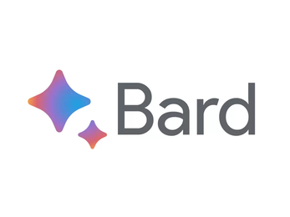
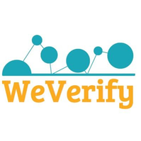


COMPETITORS
Company | Sentinel | Intel | Bard | We Verify | Chat GPT | SPOT
Video
Audio
Text
Picture
SPOT is one shop solution to all fake detection requirments from videos to reports to document verification

Slide 17

NEW MARKET
AI-Driven Content and Media Verification:There will be a need for more advanced AI tools that can not only detect fakes but also provide forensic analysis and certification of media authenticity
Music industry: Introducing an innovative AI authenticator tool to safeguard the music industry, ensuring artists' intellectual property. This cutting-edge solution employs advanced algorithms to verify and protect ﻿musical creations, fortifying the industry against unauthorized use and piracy.
Retail industry:This is for ensuring that the product the customer buying is an authentic one which ensures seamless and secure shopping experience.
Educational institutions: We get into educational institutions for transcript or document verification.

Slide 18
EXPONENTIAL GROWTH
1. Go Global: Planning on releasing it region-specific first in the US and later on expanding it throughout North America while simultaneously working with the regulatory compliance organizations of the specific region. Finally completing the expansion phase in Europe while being in accordance with the GDPR regulations.
2. Security and Transparency: The plan is to increase the security standards to gain trust globally and provide transparency to show users how their data is being used and to build trust.
3. Partnerships and Local Expertise: We form partnerships with local organizations or experts who understand the legal and cultural landscape in each target country and can help us ensure compliance with specific regional laws and regulations.
4. Customization for Local Needs: Customize our app to recognize and handle threats that are more prevalent in specific regions.
5. Training Models: We will fine-tune the AI models based on local datasets to improve accuracy in diverse cultural contexts.
6. Partnering with Amazon Web Services (AWS): We do this for cloud infrastructure and scalability which can provide numerous benefits for businesses seeking to expand their global reach.

Slide 19

ADJACENT MARKET
E-commerce and Online Marketplaces: We want to help e-commerce platforms and online marketplaces combat counterfeit products and ensure that customers are purchasing genuine items. By analyzing product images, descriptions, and customer reviews, these apps can identify potential counterfeits and flag them for further investigation.
01
02
Recruitment firms: Introducing our cutting-edge AI authenticator tool, bolstering security for recruitment firms. Safeguard sensitive data, enhance client trust, and streamline candidate verification seamlessly. Elevate your recruitment process with advanced protection.
03
Government and Legal Affairs: We want to get into verification the authenticity of legal documents, such as contracts, affidavits, and court filings. This can help ensure the integrity of legal proceedings and prevent forgery or tampering.
04
Financial Services and Insurance: We want to verify the authenticity of financial documents, such as bank statements, insurance policies, and loan applications. This can help financial institutions prevent fraud and protect their customers' assets.

Slide 20





MARKETING STRATEGY
SOCIAL MEDIA MARKETING
EVENTS PROMOTION
CROWD FUNDING
Execute strategic advertising campaigns on prominent social media platforms, including Instagram, Facebook, and Twitter
Engage with influential figures to share their unbiased perspectives on the app's effectiveness.
Promote in relevant industry conferences and trade shows where potential customers and partners gather. Exhibit your app, provide demos, to generate leads and raise brand awareness.
Participate in tech events & conferences like Tech Disrupt so that we can market our product at the same time catch the eye of potential investors.
These campaigns generate significant media attention and social media buzz, boosting brand awareness and visibility.
These campaigns demonstrate strong customer support and validate the business's concept, strengthening brand reputation and credibility.
PARTNERSHIPS
REFERRALS
Integrating the app into their platforms, social media companies can equip their users with a robust tool to combat the spread of misinformation.
Our app can significantly broaden its reach, tap into new customer segments, get brand recognition, increase customer base, and accelerated revenue growth
Referral programs are a very cost-effective way to acquire new customers, as they leverage the trusted recommendations of existing customers. .
Referral programs can help to increase brand awareness by reaching a wider audience of potential customers.

Slide 21
SALES STRATEGY:BUSINESS MODEL
FREEMIUM $0 | INDIVIDUAL (1 User) $20/user/month | CELEBRITY (1 User) $100/user/month | ORGANIZATIONS (10-100) $18/user/month | ENTERPRISES (100+ Users) $23/user/month
Access to 5 facial image verifications per day | Unlimited access to facial image verifications | Unlimited access to facial image verifications | Unlimited access to facial image verifications | Unlimited access to facial image verifications
Access to 5 audio verifications per day | Unlimited access to audio verifications | Unlimited access to audio verifications | Unlimited access to audio verifications | Unlimited access to audio verifications
Unlimited access to text detection | Unlimited access to text detection | Unlimited access to text detection | Unlimited access to text detection | Unlimited access to text detection
Access to one social media profile verifications per day | Unlimited access to social media profile verifications | Unlimited access to social media profile verifications | Unlimited access to social media profile verifications | Unlimited access to social media profile verifications
Access to 3 product barcode authentication per month | Unlimited access to barcode authentication | Unlimited access to barcode authentication | Unlimited access to barcode authentication | Unlimited access to barcode authentication
Access to 1 video authentication per month | Unlimited Access to video analysis dashboard | Unlimited access to video authentication | Unlimited access to video authentication | Unlimited access to video authentication

Slide 22
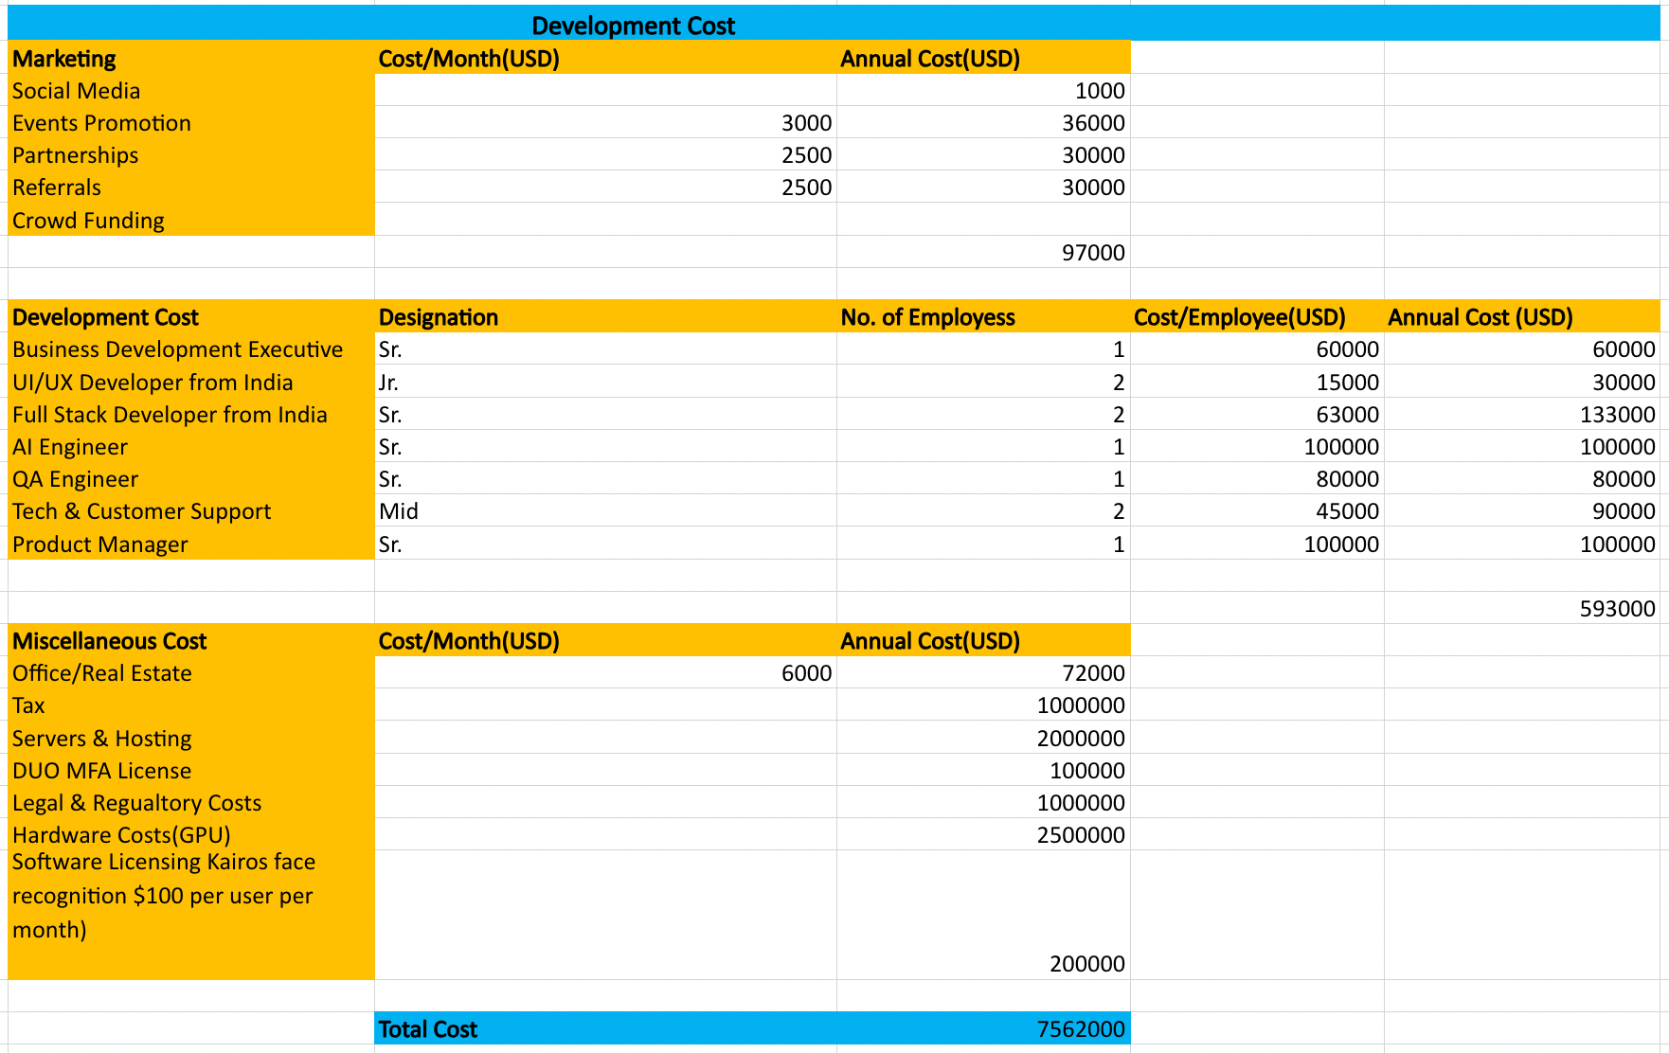
COST BREAKUP ASSUMPTION

Slide 23
SALES STRATEGY - ROI
The global artificial intelligence (AI) market size is expected to hit around USD 2,575.16 billion by 2032 as compared to USD 454.12 billion in 2022.
 | FY 24(USD) | FY25 (USD) | FY26 (USD)
Subscription Revenue | -2,400,000 | 10,500,000 | 20,00,000
No. of Users | 100,000 | 300,000 | 600,000
Commission Revenue | Commission Revenue | Commission Revenue | Commission Revenue
Vendors | -523,000 | 750,000 | 1,000,000
Advertising Revenue | Advertising Revenue | Advertising Revenue | Advertising Revenue
Clicked Based | -10,000 | 19,999.99 | 35,000
Total Revenue | 2,933,000 | 11,269,999.99 | 21,035,000

Slide 24
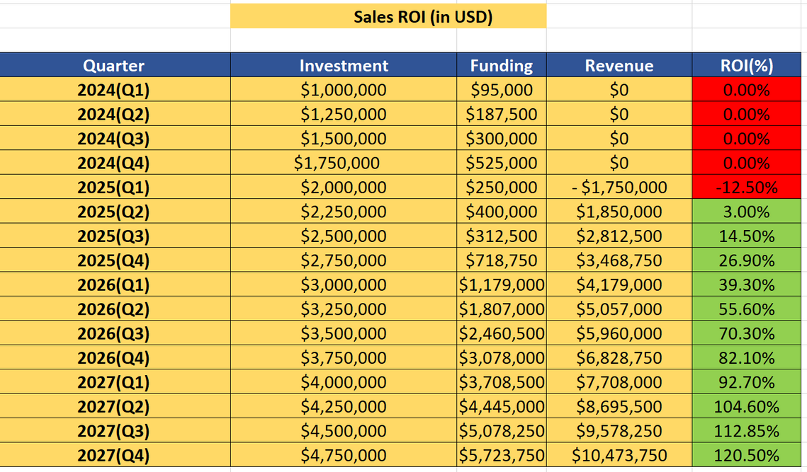
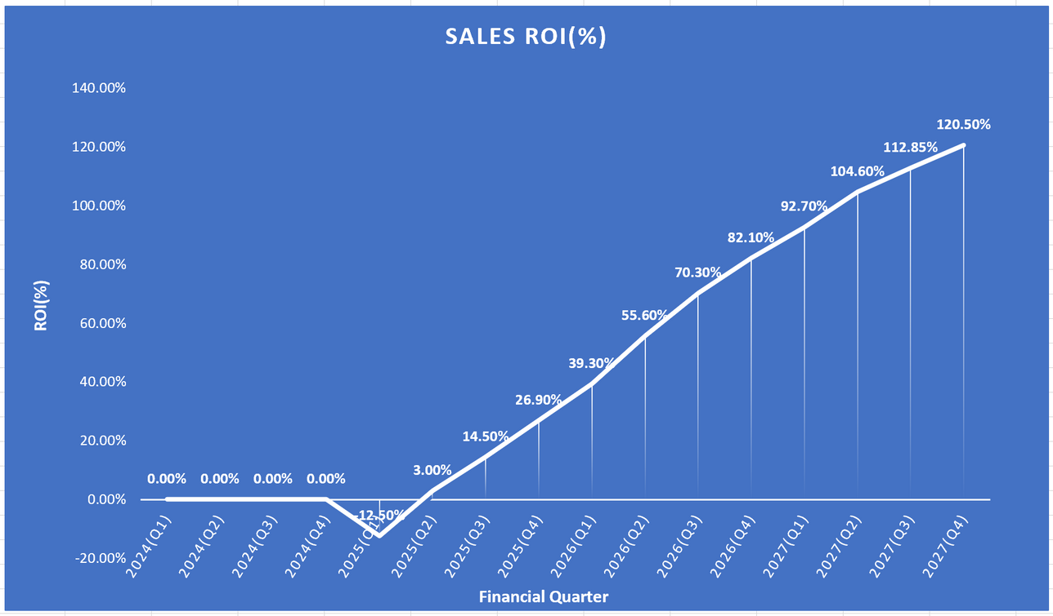
SALES ROI- J CURVE

Slide 25
AFTERMARKET SALES: BUSINESS MODEL
 | FY 25(USD) | FY 26(USD) | FY 27(USD)
Premium Subscription (Influencers) | 900,000 | 2,000,000 | 3,500,000
No. of Users | 9,000 | 20,000 | 35,000
Subscription Revenue | 2,400,000 | 7,200,000 | 14,400,000
No. of Users | 100,000 | 300,000 | 600,000
Commission Revenue | Commission Revenue | Commission Revenue | Commission Revenue
Vendors | 500,000 | 800,000 | 1,000,000
Advertising Revenue | Advertising Revenue | Advertising Revenue | Advertising Revenue
Clicked Based | 20,000 | 35,000 | 50,000
Total Revenue | 4,545,000 | 15,545,000 | 30,810,000

Slide 26
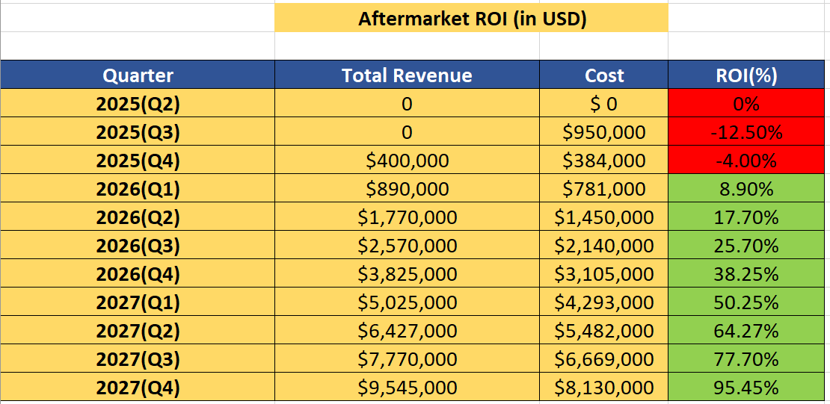
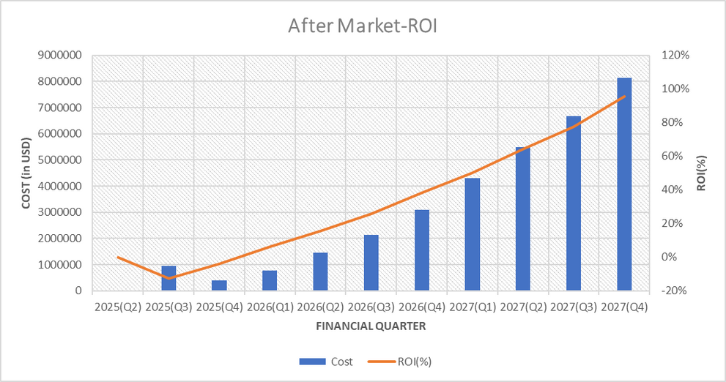
Aftermarket revenue breakdown
From 2025 to 2027, our income from the Aftermarket
approach increased 3X, while profits increased 7X.
This involves scaling operations, improving customer support, and managing infrastructure efficiently to accommodate increased user demand.
It's a crucial period where the startup shifts its focus from development and launch to sustaining and growing the business.

Slide 27
After-Market features:
Blockchain Tracking - Utilize blockchain to provide immutable record of product history and analysis
Authenticity Grading - Provide granular grading of authenticity level rather than binary decision
Machine Learning R&D - Continued research into new techniques to improve accuracy and generalizability. Journalistic article verification(source) to combat misinformation
Brand Portal - Provide insights dashboard and tools for brands to manage counterfeit issues
Reseller Marketplace - Allow users to resell products confirmed as authentic by the app

Slide 28

THANK
YOU

